Slide 1

SENTIMENT ANALYSIS OF INCOMING HELPDESK CALLS
Project Type:
Supervised Machine Learning Classification
Key Feature:
Multi-language & Mixed-language Support

Slide 2

PROBLEM STATEMENT
Customer support teams receive many helpdesk tickets every day.
Customers express their issues and emotions in different languages and mixed formats.
Challenges:
• Manual sentiment identification is slow
• Mixed-language tickets are hard to analyze
• Difficult to prioritize negative customer issues

Slide 3
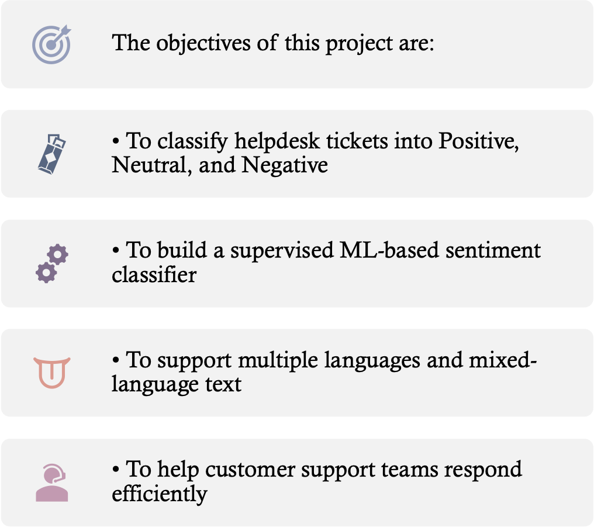
PROJECT OBJECTIVE

Slide 4

UNIQUE FEATURE: FLEXIBLE LANGUAGE SUPPORT
Multi-Language Handling
This project is designed to handle tickets written in:
• English
• Hindi
• Spanish
• Mixed Language (English + Hindi)
Why this is Important
• Real users do not always write in one language
• Mixed-language tickets are common in real-world systems
• The model works without strict language dependency

Slide 5

DATASET OVERVIEW
The dataset contains customer support ticket records including:
• Ticket subject and description
• Customer-related attributes
• Ticket-related attributes
• Sentiment labels (Positive / Neutral / Negative)
Dataset Size
• Total records after cleaning: 8469
• Multi-class labeled dataset

Slide 6

DATA CLEANING & PREPROCESSING
The following preprocessing steps were performed:
• Removed irrelevant columns (IDs, emails, timestamps)
• Handled missing numeric and categorical values
• Removed records without sentiment labels
• Ensured clean and consistent structured data
This step reduced noise and improved learning quality.

Slide 7
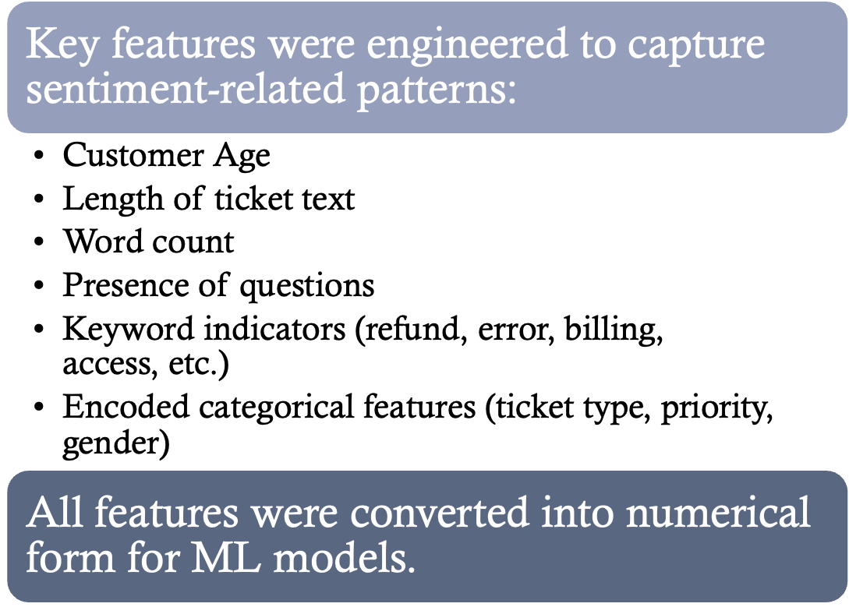
FEATURE ENGINEERING

Slide 8
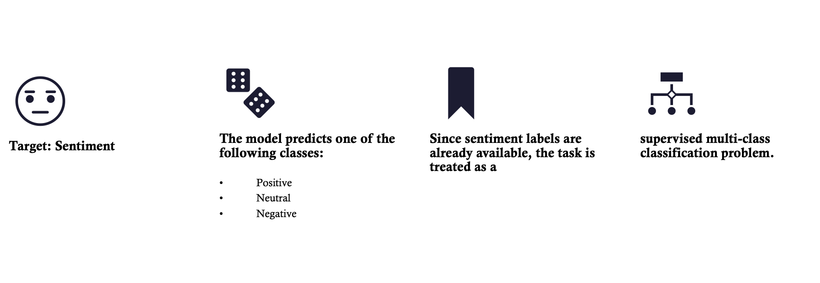
TARGET VARIABLE (SUPERVISED LEARNING)

Slide 9
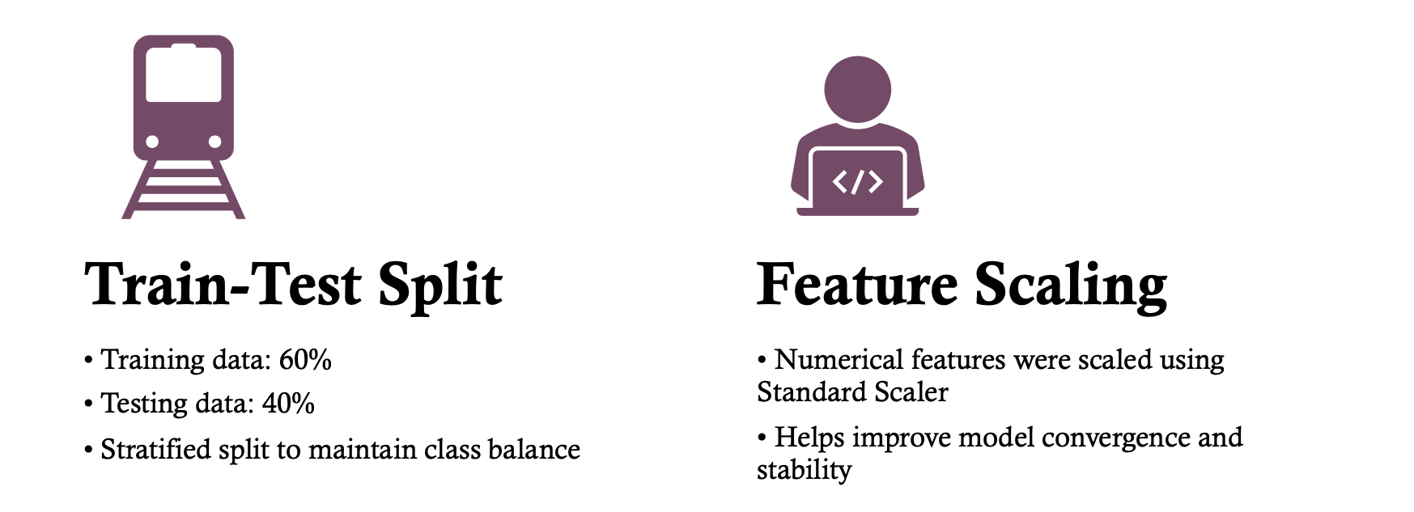
TRAIN-TEST SPLIT & SCALING

Slide 10

MACHINE LEARNING MODELS USED
Multiple supervised ML models were trained and compared:
• Logistic Regression
• K-Nearest Neighbors (KNN)
• Decision Tree
• Random Forest
• Gradient Boosting
• XGBoost
• Support Vector Machine (SVM)
This helped identify the most suitable model.

Slide 11
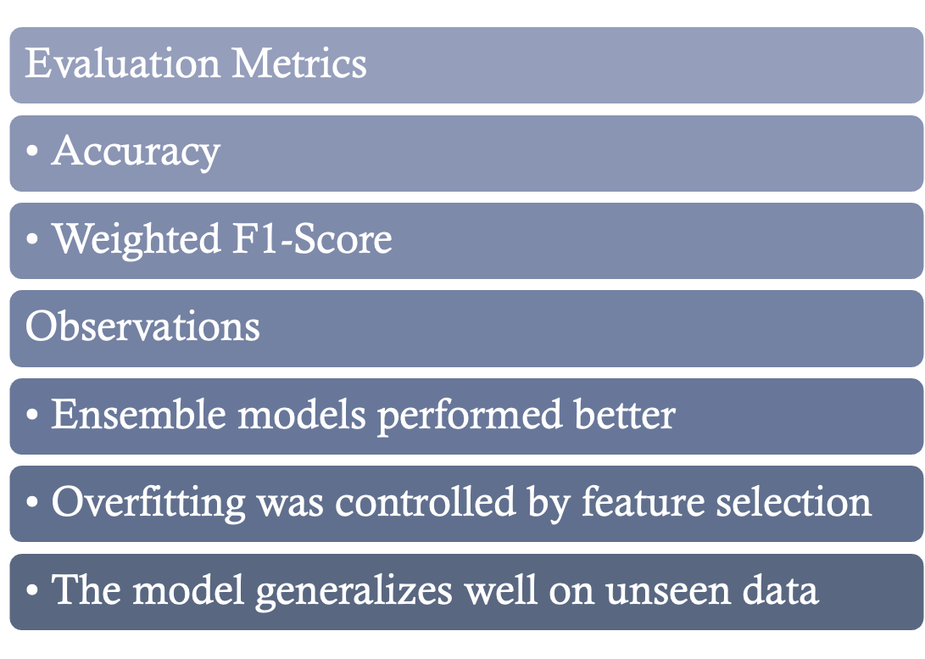
MODEL EVALUATION

Slide 12

FINAL ONE-LINE PROJECT STATEMENT
“This project uses supervised machine learning on engineered numerical features to classify multilingual and mixed-language helpdesk tickets into positive, neutral, and negative sentiments.”

Slide 13

CONCLUSION & FUTURE SCOPE
Conclusion
• Built a supervised ML-based sentiment analysis system
• Supports English, Hindi, Spanish, and mixed-language text
• Classifies helpdesk tickets into three sentiment categories
• Helps automate customer sentiment understanding
Future Enhancements
• Hyperparameter tuning
• Real-time ticket sentiment monitoring
• Integration with customer support dashboards

Slide 14

THANK YOU

